Slide 1
Ordered list

Slide 2
Agenda
Ordered list
Sample output
Ordered list implementation

Slide 3
Ordered list
The list created with numbers or alphabets are called Ordered list.
Example:
List with numbers
List with roman numbers
List with Alphabets
Syntax:
<ul> // Used to hold all the list of elements together with int numbers by default
<li> Item 1</li>
<li> Item 2</li>
</ul>

Slide 4
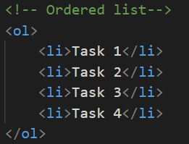
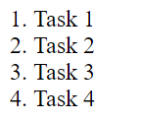
Sample output

Slide 5
Ordered list implementation
Let’s see Ordered list implementation.

Slide 6
Summary
Ordered list is shown with numbers by default.
We have seen practical implementation of the same.
DO NOT WRITE ANYTHING
HERE. LEAVE THIS SPACE FOR
WEBCAM

Slide 7
Thank You
Proprietary content. ©Great Learning. All Rights Reserved. Unauthorized use or distribution prohibited

